Slide 1

STOCK & WORK ORDER ANALYSIS
SUBMITTED BY
MEENA R

Slide 2


SQL
Sql , which stands for Structured Query Language.
Sql is a standardized programming language used for managing and manipulating relational databases.
It allows users to perform various operations on the data stored in databases, such as querying, updating, inserting, and deleting data.

Slide 3

FEATURES OF SQL
Relational Database Management System (RDBMS)
Easy to use
Storing Data is secure
Open Source & Free to download
Compatible on many Operating systems.

Slide 4

DBMS
DBMS is collection of data
A Database Management System (DBMS) is a software system designed to create, manage, and interact with databases.
It provides a systematic way to store, retrieve, and manipulate data, ensuring data integrity, security, and consistency.

Slide 5

RDBMS
A Relational Database Management System (RDBMS) is a type of database management system that stores data in a structured format using rows and columns.
This system allows for the creation, retrieval, updating, and management of data organized into tables.
Each table represents a specific entity, and the relationships between tables are defined through keys.

Slide 6

SQL SERVERS
My sql
Ms server
Oracle
Mango db
Workbench
Navigation

Slide 7

SQL STATEMENTS
DDL :
Data Definition Language
DML :
Data Manipulation Language
TCL :
Transaction Control Language
DQL :
Data Query Language

Slide 8
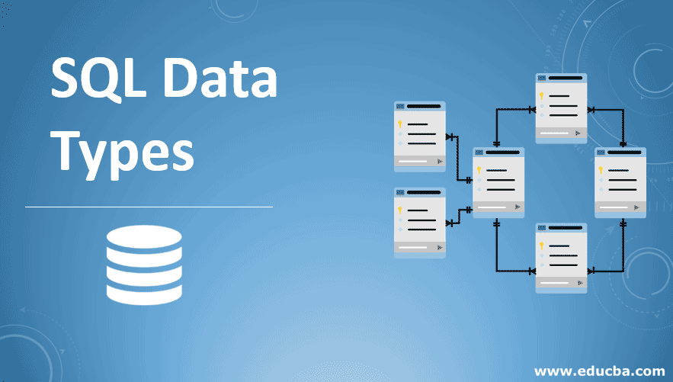
DATA TYPES
String datatype
Numeric datatype
Date & time
Picture saving

Slide 9
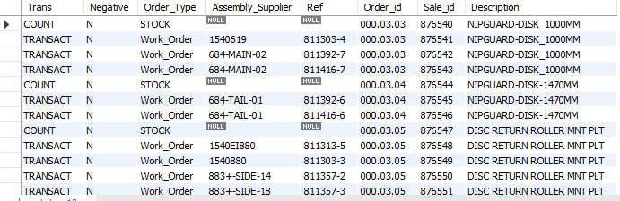
Table Importing
QUERY:
select*from order_status;
OUTPUT:

Slide 10
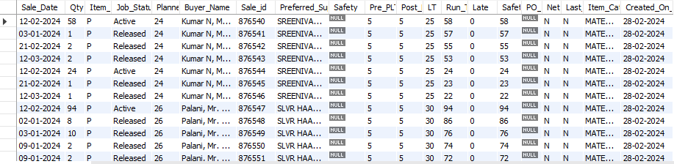
Table Importing
QUERY :
select*from date_wise_report;
OUTPUT:

Slide 11
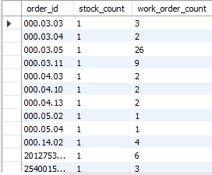
If and Count
Query :
select order_id,count(if(order_type=
'stock','yes', null)) as stock_count
, count(if(order_type='work_order','no',
null))as work_order_count from order_status
group by order_id;
Output :

Slide 12
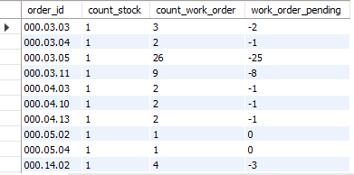
Sum
Query :
select order_id,count_stock,count_work_order,
sum(count_stock-count_work_order) as
work_order_pending from stock_workorder group by
order_id,count_stock,count_work_order;
Output :

Slide 13
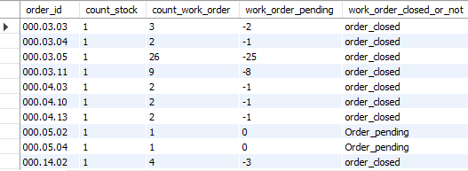
If Condition
Query :
select*,
if(work_order_pending<0,'order_closed
','Order_pending') as work_order_closed_or_not
from pending_field;
Output :

Slide 14
Table Creation
Query :
create table order_pending_status select*,
if(work_order_pending<0,'order_closed
','Order_pending') as work_order_closed_or_not
from pending_field;
Output :

Slide 15
Table Creation and Join
Query :
create table order_supplier_report select
date_wise_report.Sale_Date,date_wise_report.Qty,date_wise_report.Item_Type,date_wise_report.Job_Status,date_wise_report.Planner,date_wise_report.Buyer_Name,date_wise_report.Sale_id,date_wise_report.Preferred_Supplier,date_wise_report.Safety,date_wise_report.Pre_PLT,date_wise_report.Post_PLT,date_wise_report.LT,date_wise_report.Run_Total,
date_wise_report.Late,date_wise_report.Safety_RT,date_wise_report.PO_Note,date_wise_report.Net_Neg,date_wise_report.Last_Neg,
date_wise_report.Item_Category,date_wise_report.Created_On_Date,order_status.Trans,order_status.Negative,
order_status.Order_Type,order_status.Assembly_Supplier,order_status.Ref,
order_status.Order_id,order_status.Descriptionfrom order_status
inner join date_wise_report on
order_status.sale_id =date_wise_report.sale_id ;

Slide 16
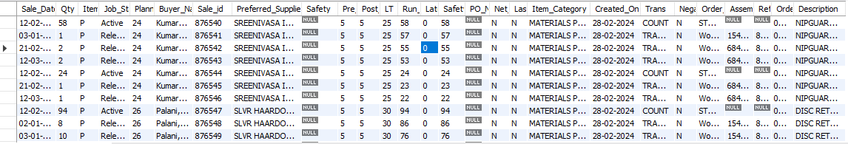
OUTPUT:

Slide 17
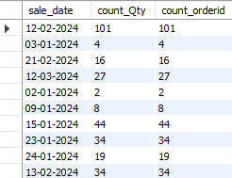
Count
Query :
select sale_date ,count(Qty) as count_Qty,
count(order_id) as count_orderid
from order_supplier_report group by sale_date;
Output :

Slide 18
STORE PROCEDURE
Query :
delimiter //
create procedure mari()
begin
select order_id,count(if(order_type='stock','yes',null))
as count_stock , count(if(order_type='work_order','no',null))
as work_order_count from order_status group
by order_id;
select order_id,count_stock,count_work_
order, sum(count_stock-count_work_order)
as work_order_pending from stock_workorder
group by order_id,count_stock,count_work_order;

Slide 19
Query :
select*, if(work_order_pending<0
,'order_closed','Order_pending') as
work_order_closed_or_not from pending_field;
select*from order_pending_status;
select sale_date ,count(Qty) as
count_Qty,count(order_id) as
count_orderid from order_supplier_report
group by sale_date;

Slide 20
Query :
Select date_wise_report.Sale_Date,
date_wise_report.Qty,date_wise_report.Item_Type,
date_wise_report.Job_Status,date_wise_report.
Planner,date_wise_report.Buyer_Name,date_wise_report.
Sale_id,date_wise_report.Preferred_Supplier,date_wise_report.
Safety,date_wise_report.Pre_PLT,date_wise_report.Post_PLT,
date_wise_report.LT,date_wise_report.Run_Total,
date_wise_report.Late,date_wise_report.Safety_RT,
date_wise_report.PO_Note,date_wise_report.Net_Neg,
date_wise_report.Last_Neg,date_wise_report.Item_Category,
date_wise_report.Created_On_Date,order_status.Trans,order_status.
Negative,order_status.Order_Type,order_status.Assembly_Supplier,
order_status.Ref,order_status.Order_id,order_status.Description
from order_status inner join date_wise_report on
order_status.sale_id =date_wise_report.sale_id ;
end //
Delimiter ;

Slide 21
OUTPUT 1:
OUTPUT 2:

Slide 22
OUTPUT 3:
OUTPUT 4:

Slide 23
OUTPUT 5:
OUTPUT 6:

Slide 24
THANK YOU!!

